Slide 1
BB2950 Day 12: Monday 11-13-17
Learning objectives:
Describe some of the methods commonly used for genetic manipulation of yeast and bacteria.
Describe how CRISPR systems mediate bacterial immunity to phage infection.
Explain how CRISPR-cas9 is used for genome editing.

Slide 2
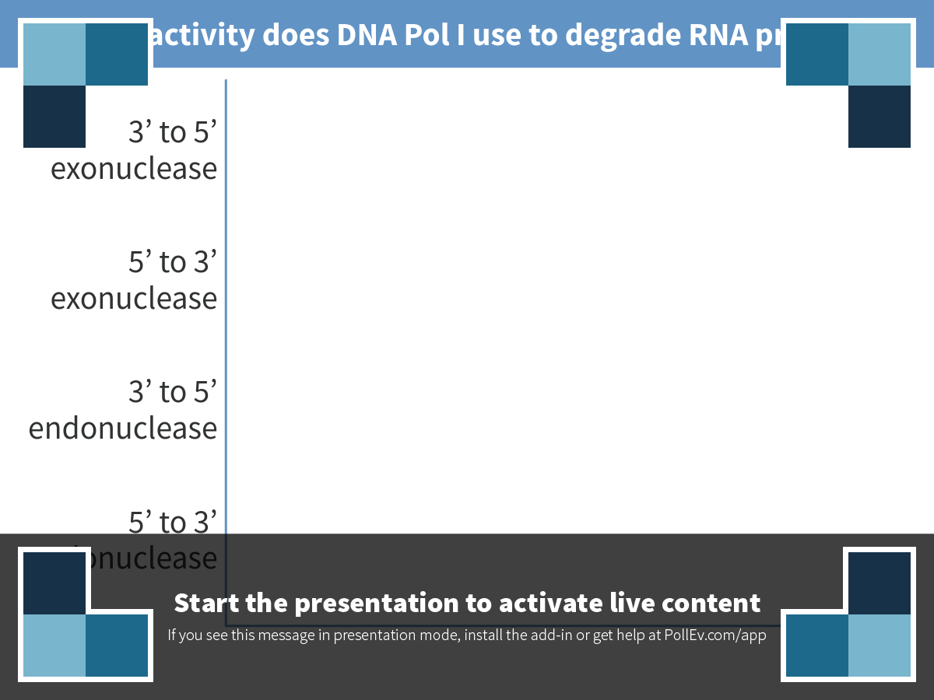
Notes:
Which activity does DNA Pol I use to degrade RNA primers?
https://www.polleverywhere.com/multiple_choice_polls/dtYsdtJg6GKT8L4

Slide 3
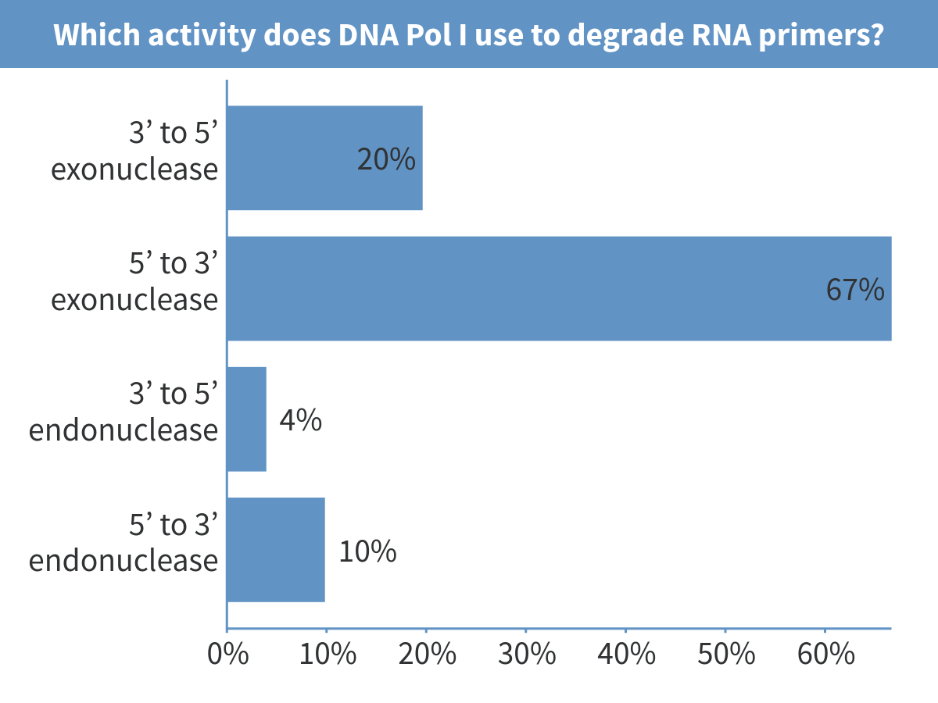
Notes:
Which activity does DNA Pol I use to degrade RNA primers?

Slide 4
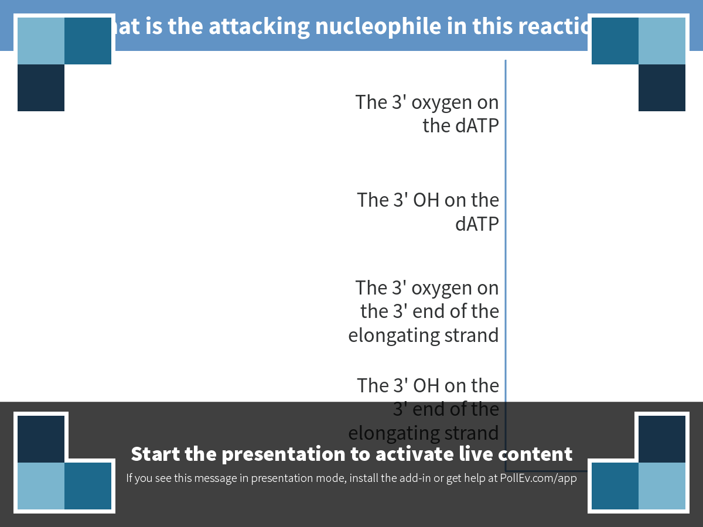
Notes:
What is the attacking nucleophile in this reaction?
https://www.polleverywhere.com/multiple_choice_polls/DZ9FJ8CxBeYMTpD

Slide 5
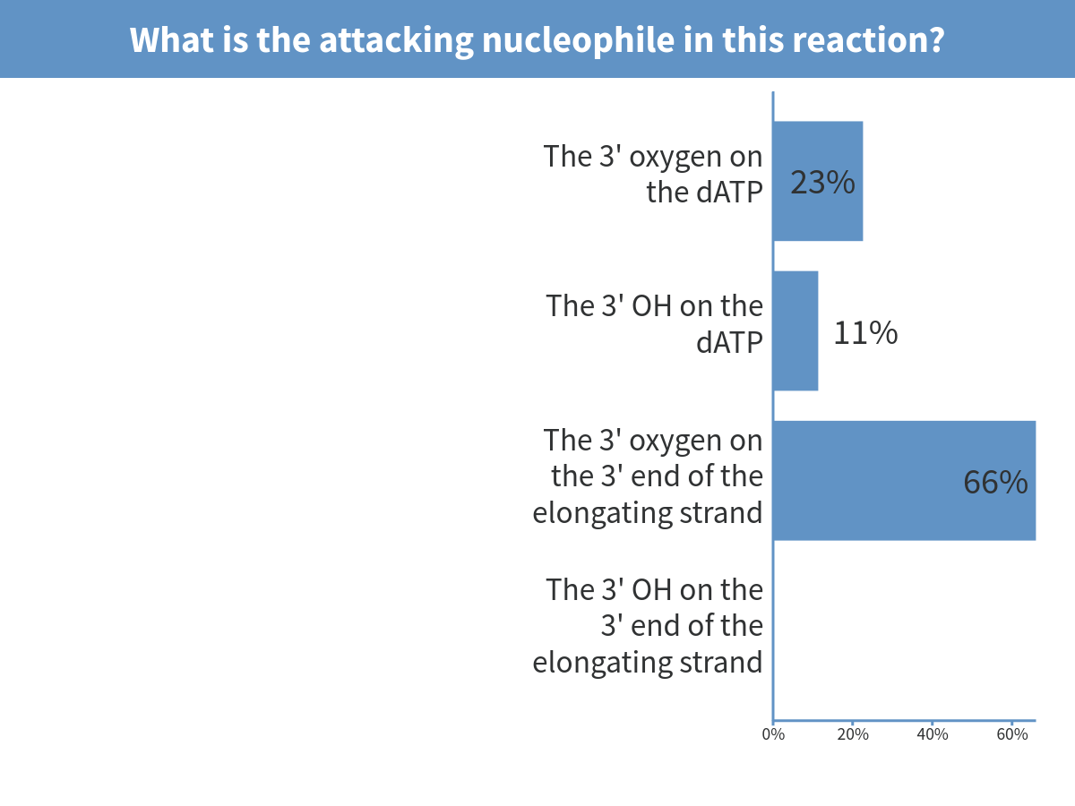
Notes:
What is the attacking nucleophile in this reaction?

Slide 6
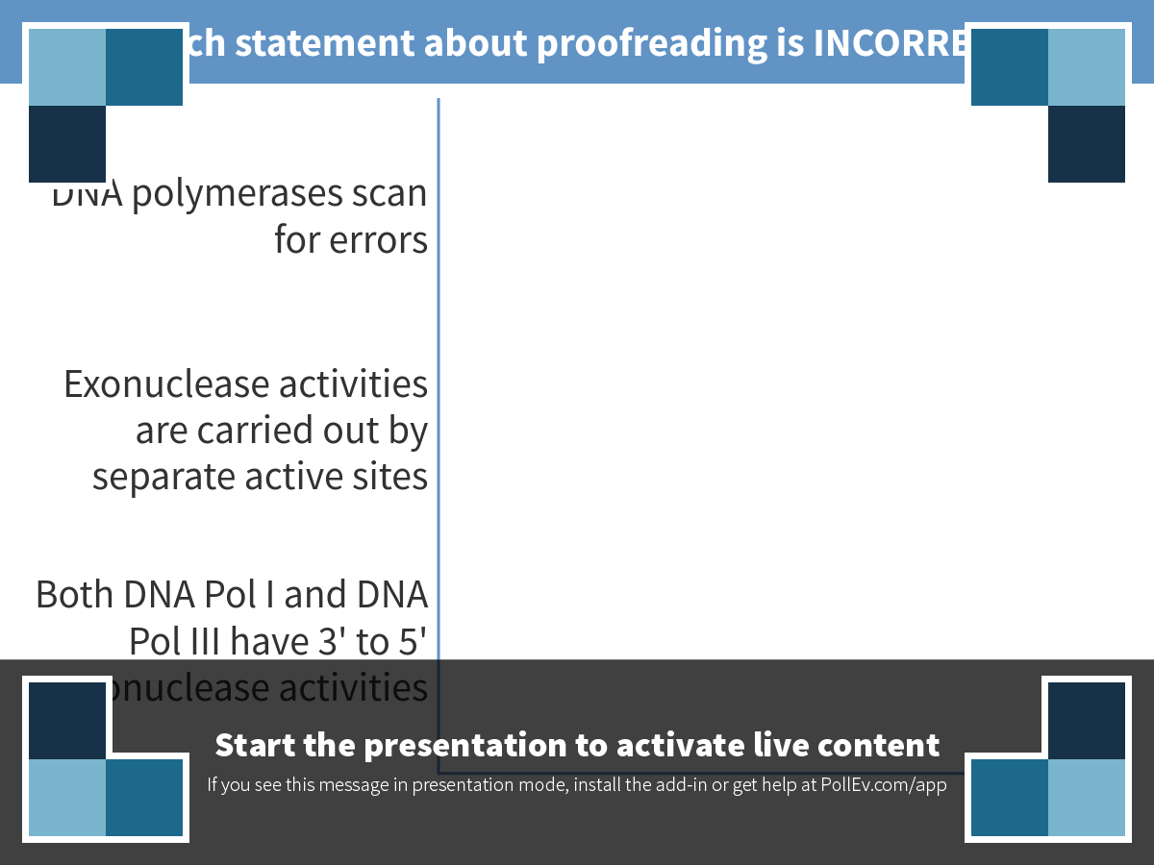
Notes:
Which statement about proofreading is INCORRECT?
https://www.polleverywhere.com/multiple_choice_polls/3BQwXjERAYlphMG

Slide 7
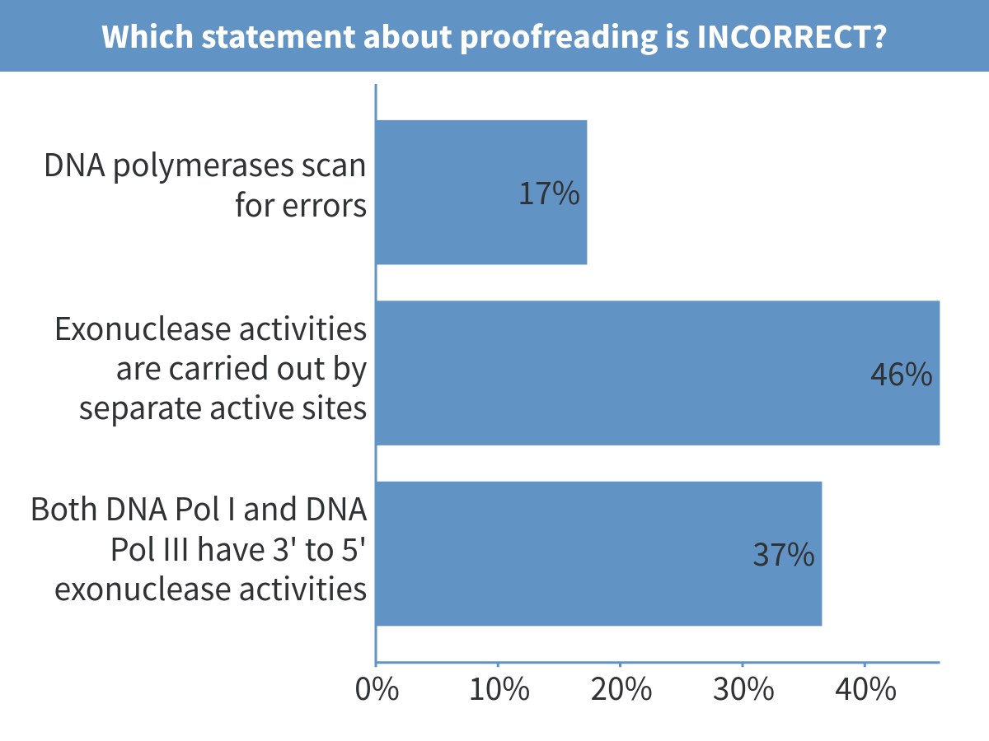
Notes:
Which statement about proofreading is INCORRECT?

Slide 8
An example of microbial genome manipulation
Hypothesis:
RNase J affects stress tolerance in Mycobacterium tuberculosis.
Approach:
Delete the gene encoding RNase J from Mycobacterium smegmatis, and test the effects on tolerance of stress.

Slide 9
Overall strategy: replace the rnase J gene with an antibiotic resistance marker
PCR product
hyg^{R}
M. smegmatis chromosome
…
rnase J
…
M. smegmatis chromosome
…
hyg^{R}
…

Slide 10
Homologous recombination
DNA strands are broken and re-ligated to the ends of different strands.
Breaking and re-attaching happens within homologous sequences (identical or nearly identical).

Slide 11
Overall strategy: replace gene with an antibiotic resistance marker
Add a plasmid to increase the recombination efficiency
PCR product
hyg^{R}
M. smegmatis chromosome
…
rnase J
…

Slide 12
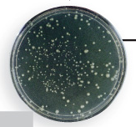
Improving the recombination efficiency of M. smegmatis with a phage recombination gene
E. coli origin of replication
M. smegmatis origin of replication
Transform into M. smegmatis
pRecombineering
Select on media containing Kanamycin
Phage recombinase genes
Kanamycin resistance gene

Slide 13
The gene replacement cassette is a PCR product made from a plasmid template
Hygromycin resistance gene
M. smegmatis sequence upstream of rnase J
M. smegmatis sequence downstream of rnase J
pKnockout
E. coli origin of replication
Ampicillin resistance gene
PCR
hyg^{R}

Slide 14
Transformation
Putting it all together
kan^{R}
pRecombineering
Drug selection (kan)
pKnockout
PCR
hyg^{R}
Transformation
Drug selection (hyg)
Grow in the absence of drug
Test the phenotype of the strain!

Slide 15
PCR
Transformation
Homologous recombination is naturally very efficient in budding yeast (Saccharomyces cerevisiae)
Drug selection
Test the phenotype of the strain!

Slide 16
Homologous recombination-based methods are very inefficient in mammals and many other organisms
Other challenges of working with mammalian cells include:
Limited starting material
Slow growth
Diploidy

Slide 17
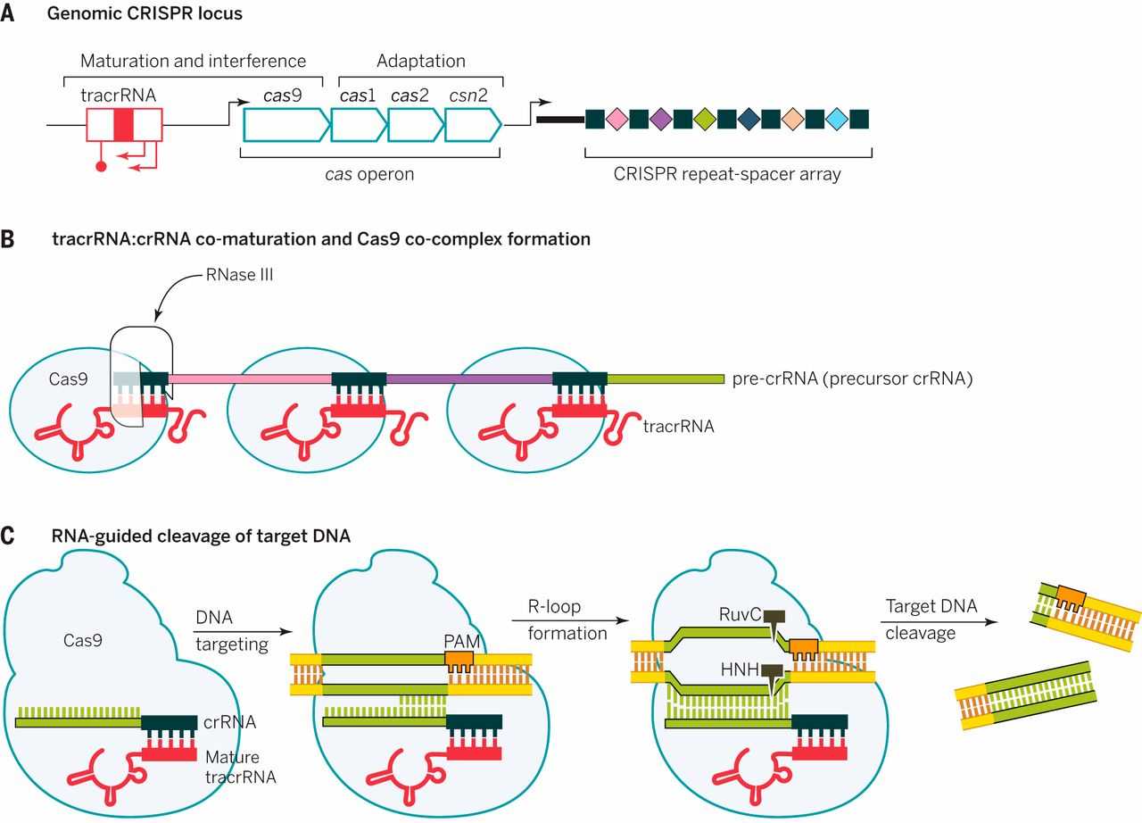
CRISPR-mediated immunity to phage infection in Streptococcus pyogenes
Doudna and Charpentier. Science 2014;346:1258096
Notes:
Point out phage sequences
Point out spacers
Point out where RNase cleaves
Point out that PAM AND complementary RNA are needed for recognition by Cas9
Point our two active sites

Slide 18
CRISPR-mediated immunity to phage infection in Streptococcus pyogenes
Doudna and Charpentier. Science 2014;346:1258096
Notes:
Point out phage sequences
Point out spacers
Point out where RNase cleaves
Point out that PAM AND complementary RNA are needed for recognition by Cas9
Point our two active sites

Slide 19
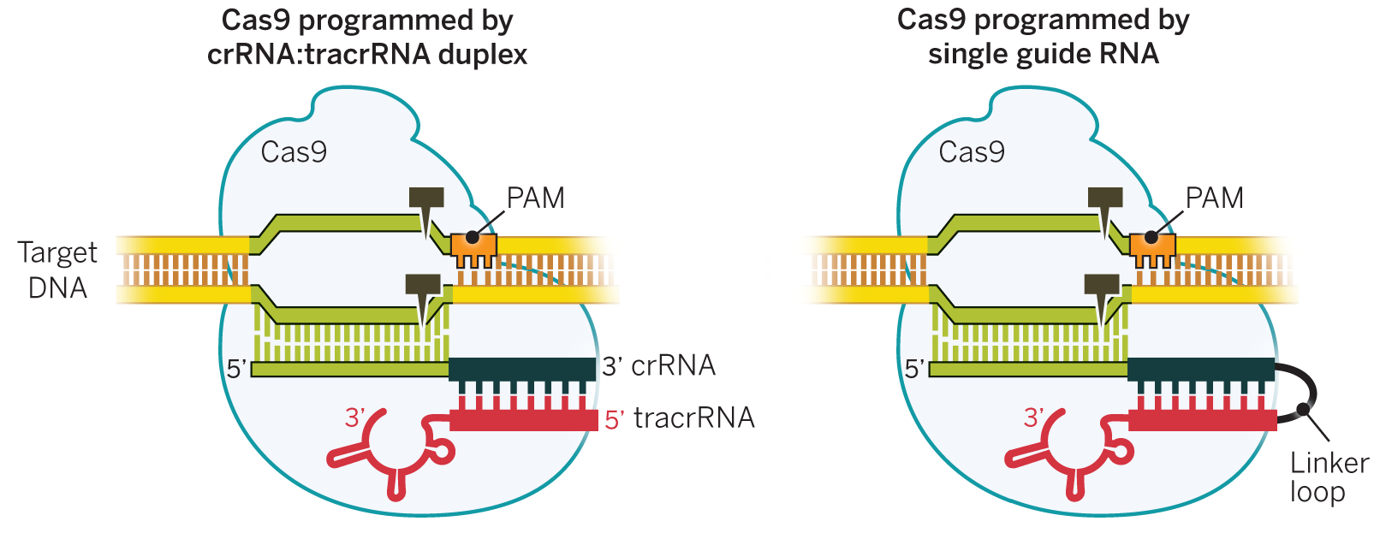
Linking 2 RNAs together to make a single sgRNA
Natural system
Engineered system
Doudna and Charpentier. Science 2014;346:1258096

Slide 20
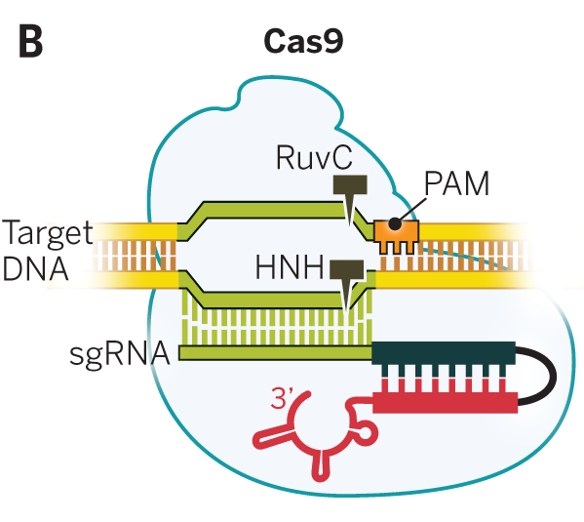
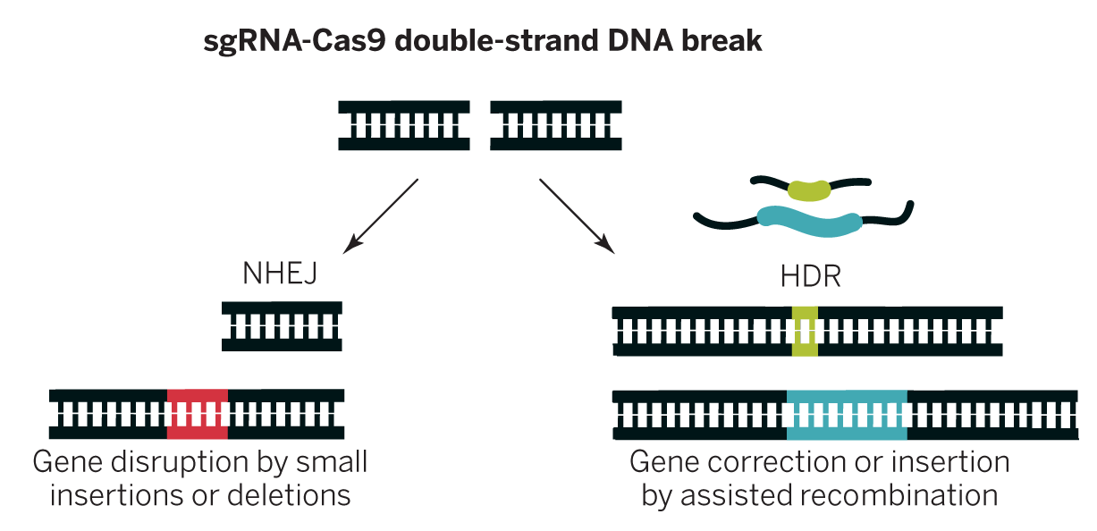
sgRNA-Cas9 together cause a double-strand break at a location specified by the sgRNA sequence and presence of a PAM
What type of enzyme is Cas9?
Target DNA
Doudna and Charpentier. Science 2014;346:1258096

Slide 21
Cas9-induced double-strand breaks can be repaired in two ways useful for genetic engineering
Doudna and Charpentier. Science 2014;346:1258096
Notes:
Why would you want to use the NHEJ method? The HDR method?

Slide 22
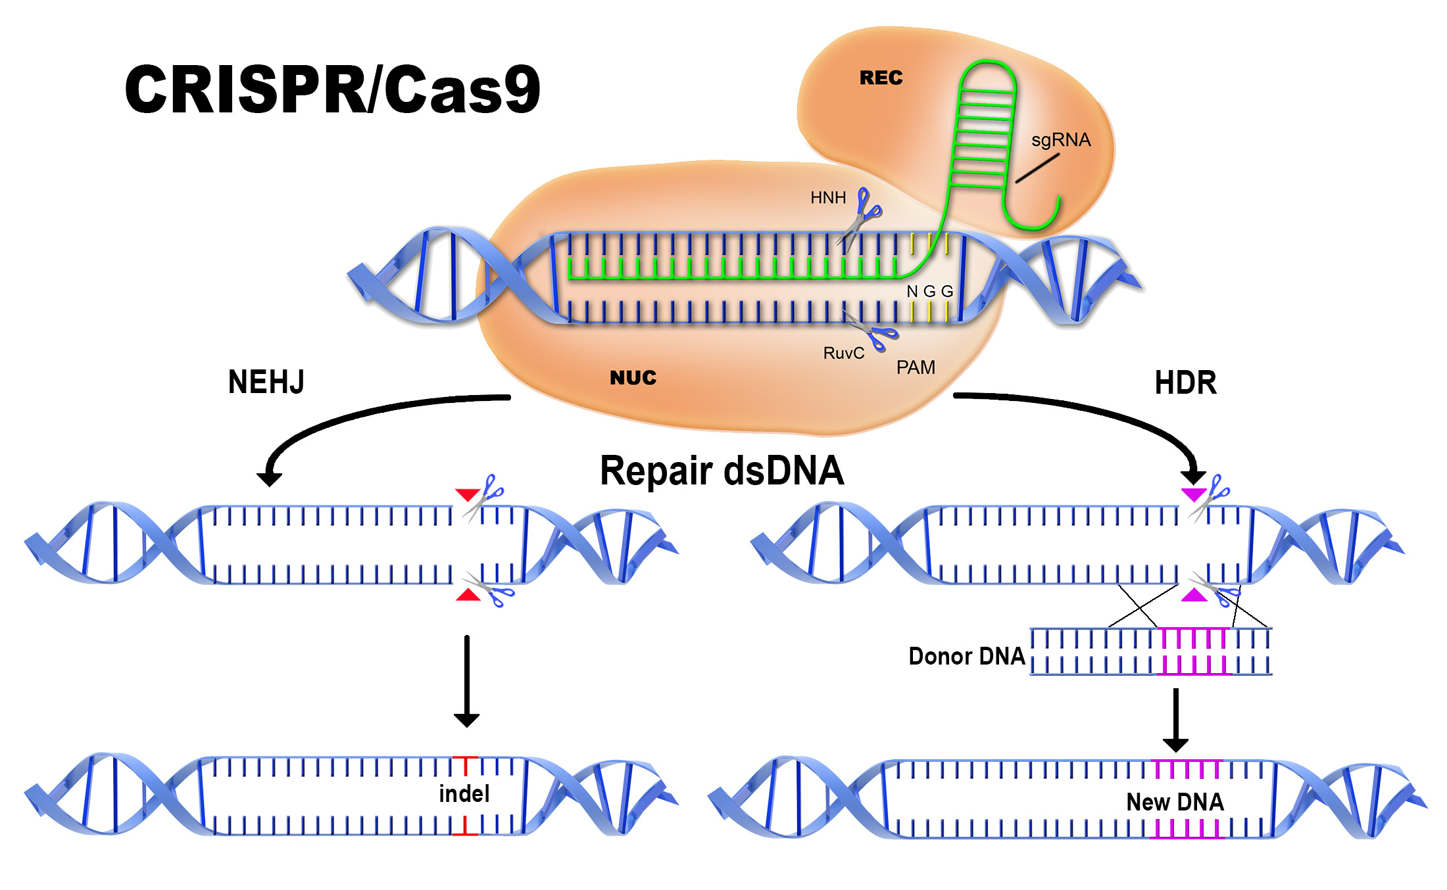
Another view of CRISPR-Cas9 genome editing
Cas9
Non-homologous end joining
Homology-directed repair
Graphic from: http://www.aati-us.com/product/fragment-analyzer/CRISPR

Slide 23
Mean: 75.9
Median: 80

